Slide 1
UTILITY APP
NAME : SAI TEJA JEEGURU
ID : MST01-0017

Slide 2
SUMMARY
A versatile web application that provides various utility tools and functions to users, which include features for tasks such as file manage, text manipulation, calculations, currency converter functions.

Slide 3

HOMEPAGE

Slide 4
Feedback Button
About Us Button
Contact Us Button
Currency Converter Button
Notes Button
Calculator Button

Slide 5

IN NOTES CATEGORIES BUTTON YOU CAN ABLE TO SELECT THE NEW (create a new notes) AND OPEN (to open previous notes)

Slide 6
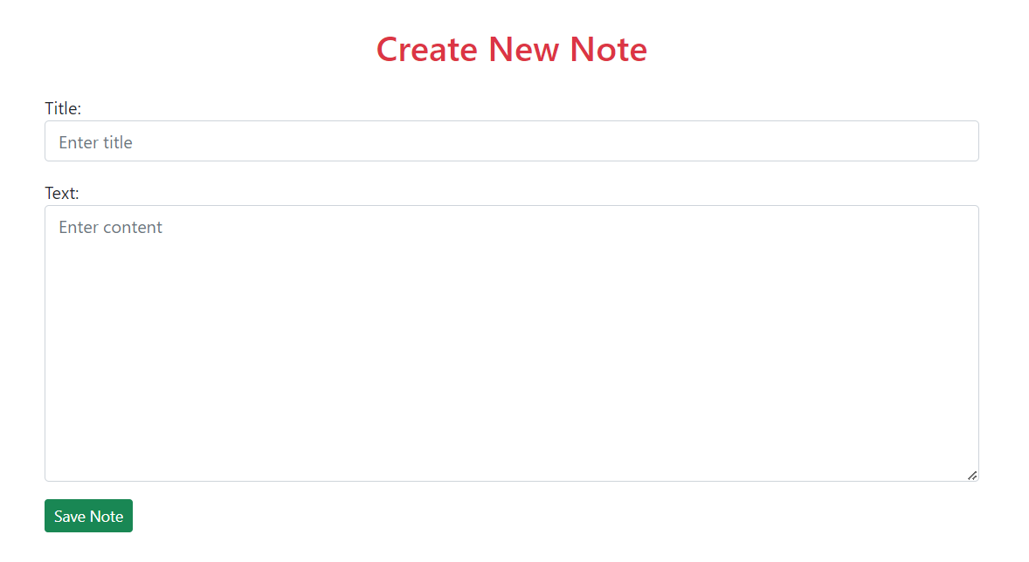
NOTES
IN NEW WHICH IS USED TO CREATE NEW NOTES

Slide 7
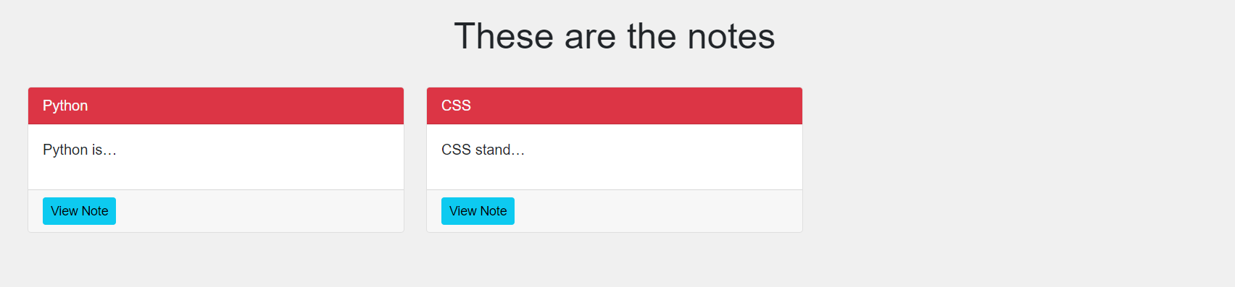
IN OPEN WHICH IS USED TO OPEN PREVIOUS NOTES

Slide 8
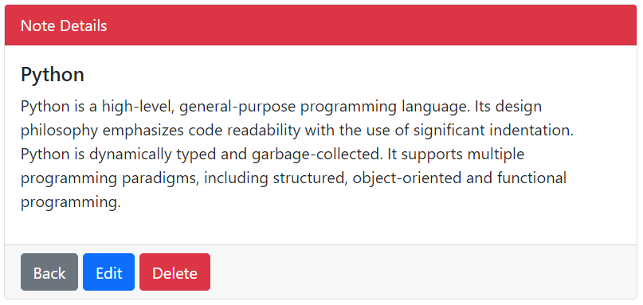
DETAILS IN THE NOTES
IN DETAILS NOTES, THE USER CAN EDIT PREVIOUS NOTES.
IN DETAILS NOTES, THE USER CAN DELETE PREVIOUS NOTES.

Slide 9
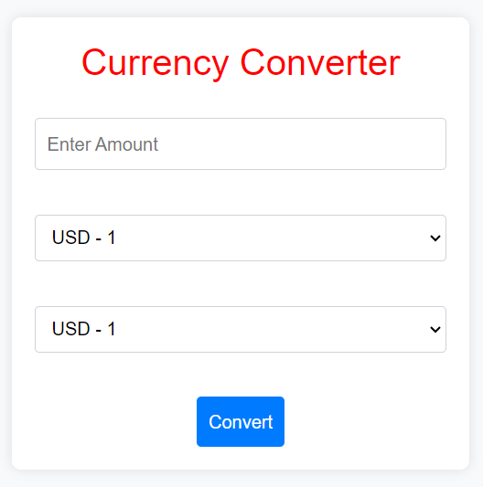
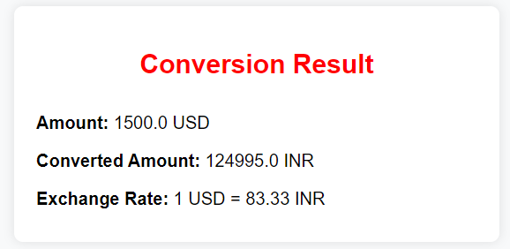
CURRENCY CONVERTER
CURRENCY CONVERTER INTERFACE
CURRENCY CONVERTER RESULT INTERFACE

Slide 10
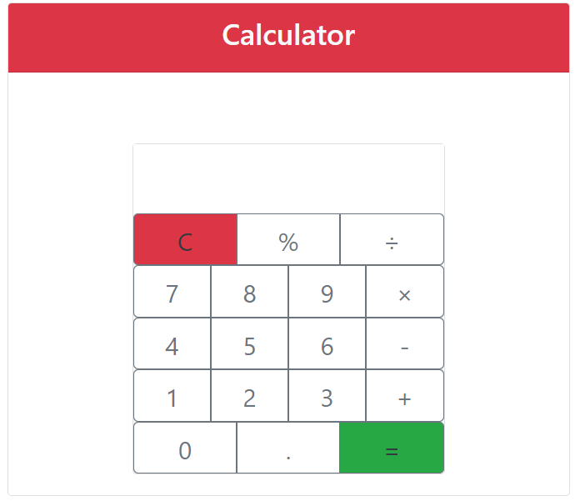
CALCULATOR INTERFACE

Slide 11
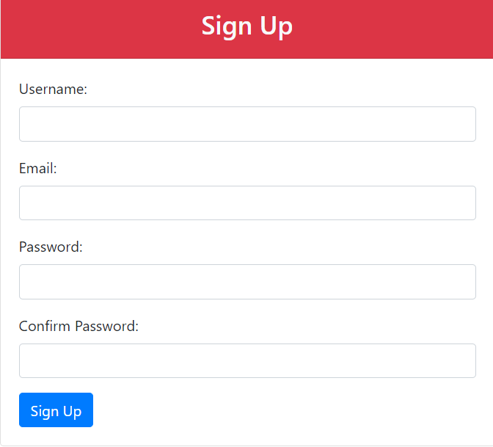
IN SIGN UP PAGE YOU CAN SIGN IN USING YOUR DETAILS

Slide 12
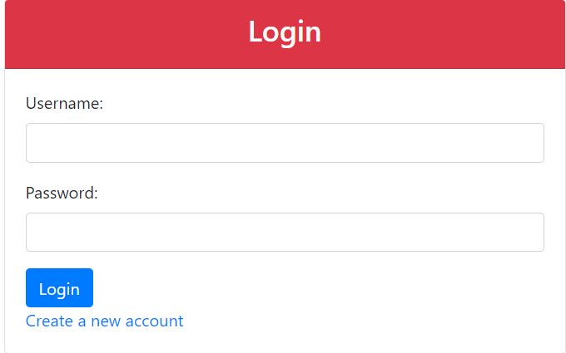
IN LOGIN PAGE YOU CAN LOGIN USING YOUR USERNAME AND PASSWORD

Slide 13
THANK YOU

